Slide 1
OXALATES
Shubhankar Kapoor
CE 529: Application and Advanced Topics of Colloid and Surface Phenomena

Slide 2
Overview
Introduction to Oxalates
Occurrence
Structure of the polymorphs of the Calcium Oxalate (CaOx)
Mechanism of Kidney Stone Formation
Stone Inhibitors and Promotors
Study by Yu et al.

Slide 3
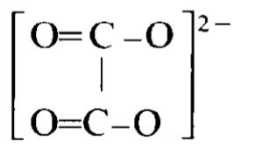
Introduction
Oxalate is the dianion with the formula C₂O₄²⁻ .
The name is attributed to its occurrence in the plant Oxalis (wood sorrel)
Oxalates have been long known to occur in many forms of living matter. Certain species of plants (e.g. Rhubarb) contain relatively large amounts of oxalates.
It mainly occurs as soluble sodium or potassium salts or the insoluble calcium salts.
Early interest arose due to instances of human poisoning due to ingestion of large quantity of plants with high amount of oxalate content and later due to kidney stones formation due to insoluble calcium oxalates.
The parent acid is oxalic acid, (COOH)_{2.}

Slide 4
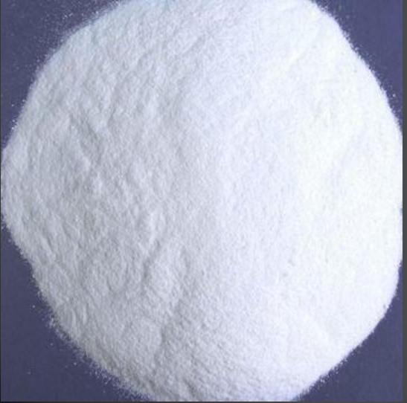
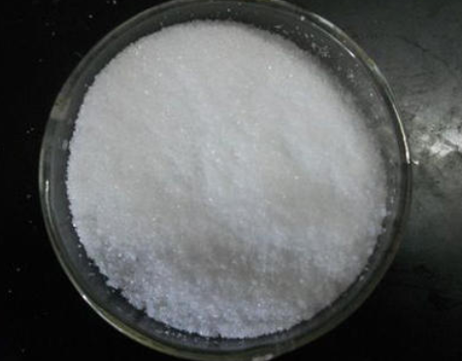
Salts of Oxalates
The oxalate ion can combine with a single metal ion or with more than one.
There are usually various hydrated forms.
Examples include Sodium Oxalates, Magnesium Oxalates, Zinc Oxalates and the all important Calcium Oxalates.
Sodium Oxalate has a formula of Na₂C₂O_{4.} It is used as a reducing agent and is primarily used for standardizing KMn0₄ solutions. It is toxic to humans and causes It can cause burning pain in the mouth, throat and stomach.
Thus, Oxalates either have no biological value to the human system or effects negatively.
Sodium Oxalate
Calcium Oxalate

Slide 5
Occurrence
In plants, the highest level are found in the families Polygonacae, Chenopodiaceae, Portulacaceae and Ficoidaceae.
In animals, oxalic acid combines with divalent cations such as calcium (Ca²⁺) and iron(II) (Fe²⁺) to form crystals of the respective oxalates which are then excreted in urine as crystals.
The excretion varies in normal children and adults from about 6 to 45 mg/day, with a mean of 20 mg/day, expressed as oxalic acid.
The crystals thus formed can transform into larger kidney stones if kidney doesn’t function properly. 80% of kidney stones are formed via calcium oxalate and phosphates.
Plant | Oxalate content
Spinach | 0.3-1.2%
Rhubarb | 0.2-1.3%
Beet Leaves | 0.3-0.9%
Tea | 0.3-2.0%
Cocoa | 0.5-0.9%
Toxicants Occurring Naturally in Foods
(National Research Council 1973)

Slide 6
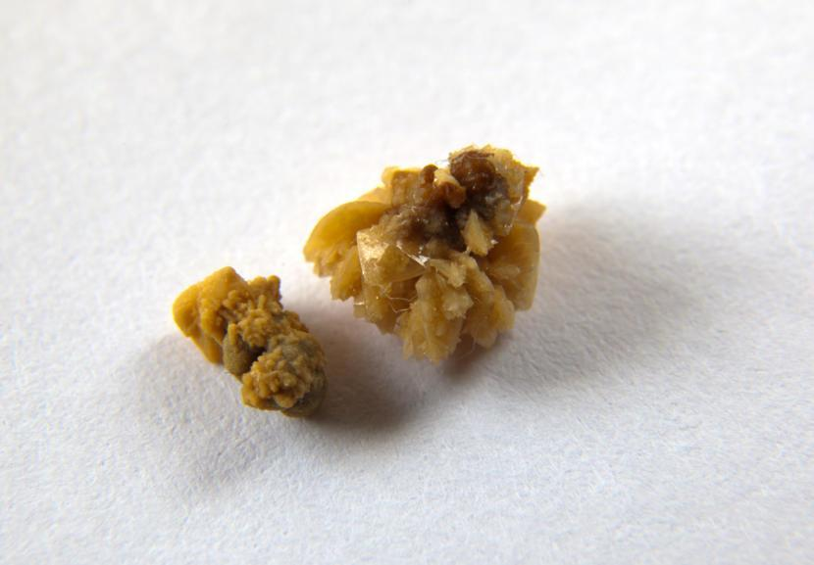
Kidney Stones
Formation of mineral deposits in the kidneys leads to the development of Kidney Stones.
Composition of kidney stones may include one or more of the following: calcium oxalate, calcium phosphates, cystine, struvite, uric acid.
In healthy individuals, crystals formed are so small that they are eliminated without any repercussions.
Due to differential state of renal morphoanatomy, this normal urine crystallization conditions gets altered affecting the crystal nucleation and growth. The crystallites formed in people suffering from urolithiasis have differences in crystal phase, particle size distribution and morphology of nano crystallites.
https://www.livescience.com/42784-kidney-stones-causes-treatments.html

Slide 7
Polymorphs of Calcium Oxalate
There are three forms of crystal phases of Calcium Oxalates that differ in the hydration number.
Calcium oxalate monohydrate(COM) is one form of calcium oxalates contributes majorly to the formation of stones in lithogenic people and is the most thermodynamically stable of the three.
Calcium oxalate dihydrate (COD) is metastable and is found more frequently in the urine of non-stone formers.
The least stable form is calcium oxalate trihydrate (COT) and is considered as a precursor phase therefore is rarely seen in urine.

Slide 8
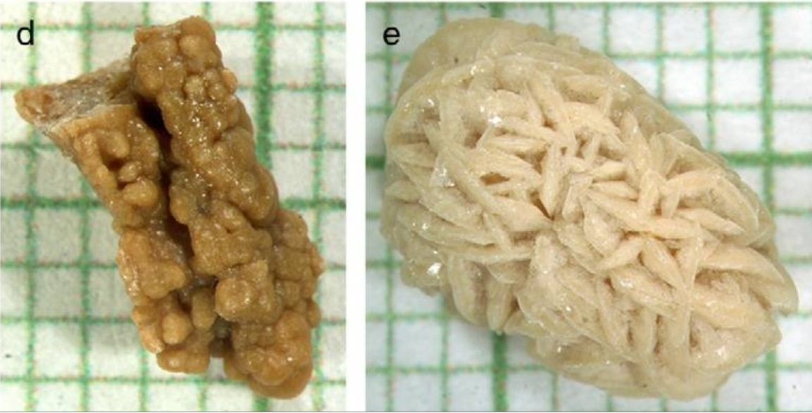
Polymorphs of Calcium Oxalate
COM has a higher affinity for epithelial cells therefore it is more likely to aggregate than COD crystals resulting in larger stones. It is therefore the COD crystals that are more commonly excreted in urine. (Wang, Thurgood Lauren et al. 2010)
COD nanocrystallites are rounded while COM have sharp edges. This results in a decrease in their surface area, reducing the tendency for them to aggregate and adhere to the epithelium.
Microscopic view of COM on left and COD on right collected from patient. (Duan, Qu et al. 2013)

Slide 9
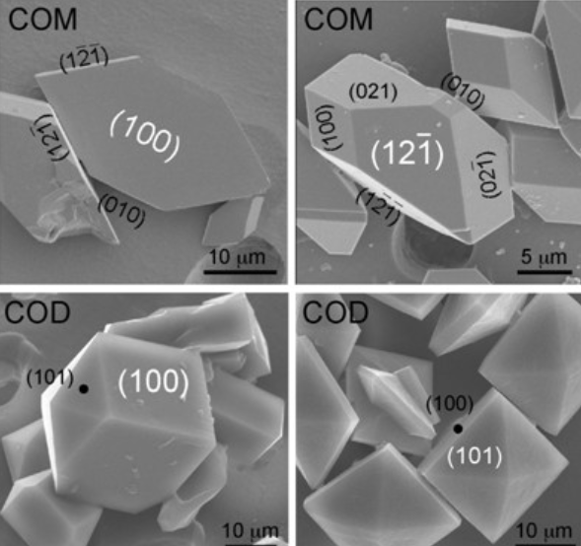
Polymorphs of Calcium Oxalate
Polymorphic Form | Formula | Stability | Crystal Structure
Monohydrate | CaC₂O₄·H₂O | Very Stable | Monoclinic (nanocrystallites have sharp edges)
Dihydrate | CaC₂O₄·(2+x) H₂O | Low Stability | tetragonal (rounded)
Trihydrate | CaC₂O₄·xH₂O, 2.5 | Least Stability | Rectangular platelets
http://slideplayer.com/slide/5131707/

Slide 10
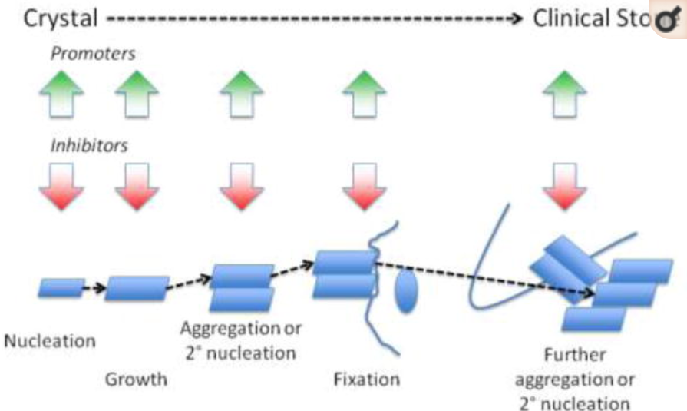
Mechanisms of Stone Formation
Mechanism include primary nucleation of stone constituent crystal, their growth with respect to the renal structure, and further secondary nucleation to form clinical stone.
Supersaturation is needed for the crystallization to occur.
It has been reported widely across literature that the urine of stone formers is more supersaturated than that of healthy individual thus favouring nucleation and growth of crystals. In both cases, CaP and CaOx are found.
Greater degree of supersaturation is associated with excessively low urine volume. (Ratkalkar and Kleinman 2011)
Sequence of Stone formation. (Ratkalkar and Kleinman 2011)

Slide 11
Mechanisms of Stone Formation
However, the occurrence of supersaturated urine is a common phenomenon for both stone-forming patients and healthy individuals.
This points to the fact that the precipitation of calcium oxalate monohydrate (COM) by itself poses no problem as long as the particles formed are allowed to pass freely through the urinary tract. (Kok and Khan 1994)
Problems occur when the particles are retained or allowed to be retained at their site of origin. The stones are usually found attached to epithelial cells lining of the renal tubules of the kidney.
Two mechanism have been put forward for this retention of particle:
Free particle mechanism (size dependence)
Fixed particle mechanism (adhesion dependence)

Slide 12
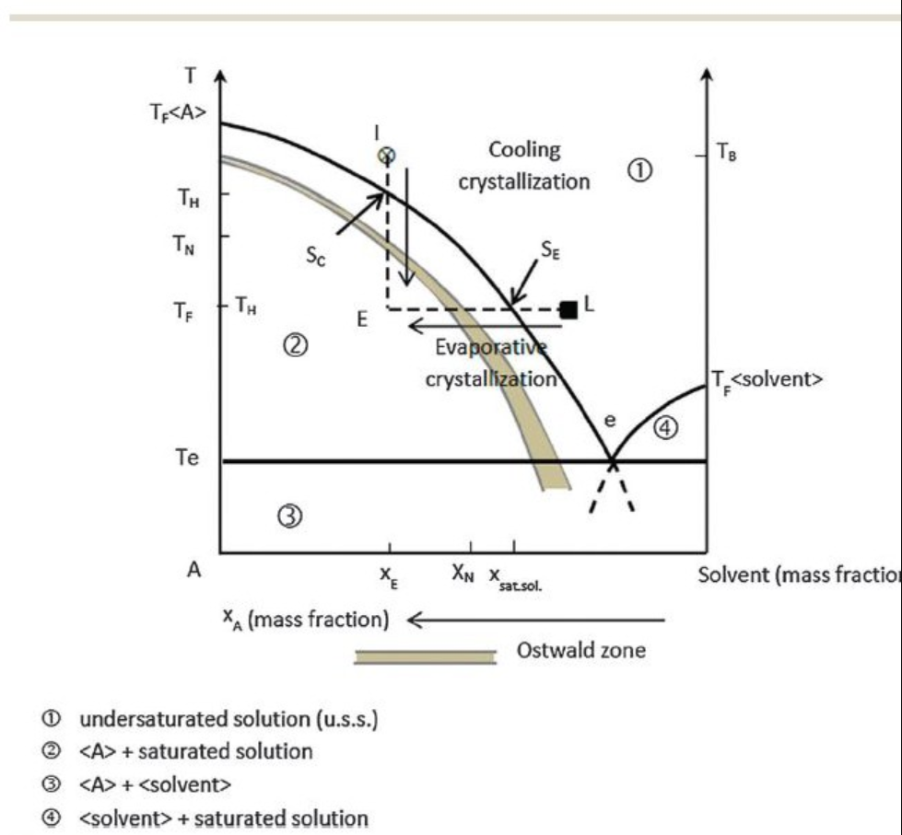
Mechanisms of Stone Formation- back to basics
https://kidneystones.uchicago.edu/in-the-place-just-right/

Slide 13
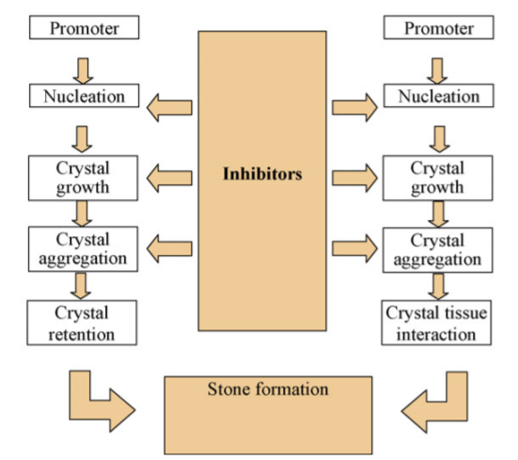
Mechanisms of Stone Formation
Calcium stone formation involves different phases of increasing accumulation of CaOx:
nucleation,
crystal growth,
crystal aggregation and
crystal retention
Summary of Stone Formation in Kidney.(Basavaraj, Biyani et al. 2007)

Slide 14
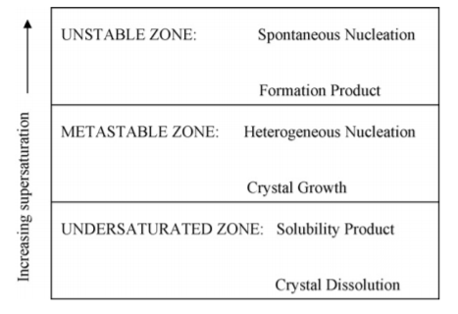
Mechanisms of Stone Formation- Nucleation
Nucleation is the formation of a solid crystal phase in a solution. It is an essential step in renal stone formation. Happens via the supersaturation of the solution.
Urine contains inhibitors of crystallisation and can hold large concentrations of solute above the thermodynamic solubility product Ksp in a metastable state.
If the concentration is increased a point where it cannot be held in solution, this concentration is known as K_{F}, which is the point of formation of crystals of oxalate in urine.
In secondary nucleation, new crystals deposit on pre-existing crystal surfaces of similar type. Secondary nucleation results in the ‘mass production’ of crystals. This is heterogenous nucleation or epitaxy.

Slide 15
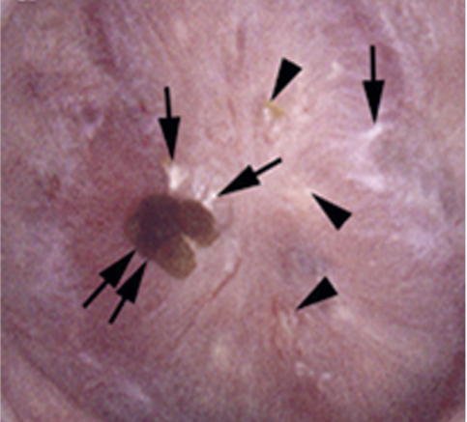
Mechanisms of Stone Formation- Nucleation
The general consensus is that crystallization in urine happens via heterogeneous nucleation because of the:
varying concentrations of various components (inhibitors, promotors and organic materials) that make heterogeneous nucleation more likely. (Al-Atar, Bokov et al. 2010) and
crystals form at a lower level of supersaturation in the presence of a solid phase.
Heterogeneous nucleation sites in urine can be epithelial cells, red blood cells, cell debris, urinary casts, other crystals and bacteria
An attached stone (paired arrows) is resting on a region of white plaque (single arrows) and intermixed with small areas of white (single arrow) and yellow plaques (arrowheads). (From Evan AP, Lingeman JE, Worcester EM, et al.

Slide 16
Mechanisms of Stone Formation- Crystal Growth
The driving force for crystallization is reduction in the binding potential energy of the atoms or molecules.
Because the bulk free energy of the clusters is less than that of the surrounding solution, several atoms or molecules in a supersaturated liquid start forming clusters.
Crystal growth is determined by the molecular size and shape of the molecule, supersaturation levels and pH of the urine.

Slide 17
Mechanisms of Stone Formation- Crystal Aggregation
As the term suggests, crystals in solution stick together and form a larger particle.
Aggregation determined by the interaction of particles and the balance of forces between them.
It can have both aggregating effects and disaggregating effects.
The main force that inhibits aggregation is the repulsive electrostatic surface charge, known as Zeta potential.
In normal physiochemical condition, repulsion occurs between the CaP crystals and tubular cells and may result in elimination of small CaP crystal by dissolution or spontaneous passage in urine. But this process is disturbed if there is an alteration in the pH or an injury to the inner membrane of kidney such as sloughed membrane fragments. (Basavaraj, Biyani et al. 2007)

Slide 18
Mechanisms of Stone Formation- Crystal Retention
While Crystal formation depends on the composition of the fluid, crystal retention depends on the composition of the renal tubular epithelial cell surface(Basavaraj, Biyani et al. 2007)
A non-adherent surface of the distal tubules, collecting ducts may provide with a defence mechanism for crystal to not to adhere but an unregulated cell surface such as expression of hyaluronic acid, osteopontin and their receptor CD44 have been shown to play crucial role in stone retention. (Verhulst, Asselman et al. 2003)

Slide 19
Confusion surrounding the formation of stones
Materials acting as site of origin for kidney stone growth remain unclear.
Suggestions have been made that COM crystals deposition may occur on a pre-formed calcium phosphate nidus, known as Randall’s plaques. But, they are not found in all individuals suffering from kidney stones, such as intestinal bypass patients. (Al-Atar, Bokov et al. 2010)
Alternatively, the free and fixed particle theories suggest that nucleation in itself doesn’t play an all important role in the kidney stone disease.
It is thus clear that the real process of kidney stone growth cannot be directly observable.

Slide 20
Stone Inhibitors & Promoters
Inhibitors do the following:
increase the Supersaturation required to initiate nucleation,
decrease crystal growth rate and aggregation,
inhibit secondary nucleation.
Promoters reduce the formation product of the supersaturated solution.
Natural inhibitors are present in the urine and inhibit the formation of stones. An imbalance between Inhibitors and Promoters is regarded as an important variable in the urinary stone formation.
Ion complexes form by Inhibitors such as Citrate and Magnesium with oxalate dissolve repeatedly in supersaturated urine leading to the rounding of crystallite edges. This gives them a smaller surface area and decreases their likelihood of adhering to a cell membrane in the urinary tract.

Slide 21
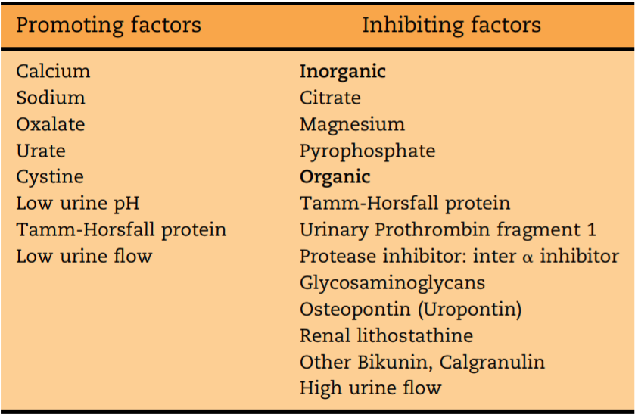
Stone Inhibitors & Promoters
Stone promoting and inhibiting compounds. (Basavaraj, Biyani et al. 2007)

Slide 22
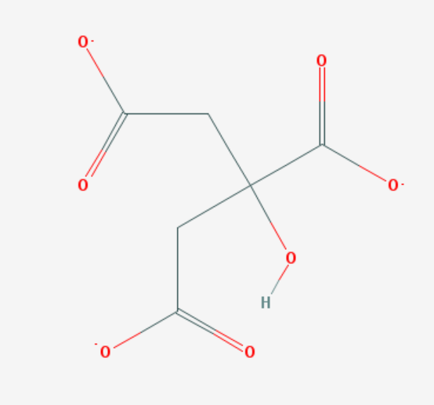
Inhibitors
Citrate
It has been widely studied for its stone inhibiting action in urine and is deemed effective against CaOx and CaP stones.
It is found naturally in the body and is circulated in blood complexed to calcium, magnesium, potassium and sodium at physiological pH of 7.4.
It is known to form complex with calcium in the urine thereby reducing the concentration of CaOx. (Basavaraj, Biyani et al. 2007)
The citrate molecule in urine not only binds calcium and therefore reduces supersaturation with respect to the calcium stone forming crystals but hinders the formation and growth of such crystals.
Urinary alkalisation by potassium citrate increases the solubility of uric acid and thus prevents the salting out of calcium oxalate by urate.
https://pubchem.ncbi.nlm.nih.gov/compound/citrate#section=Top

Slide 23
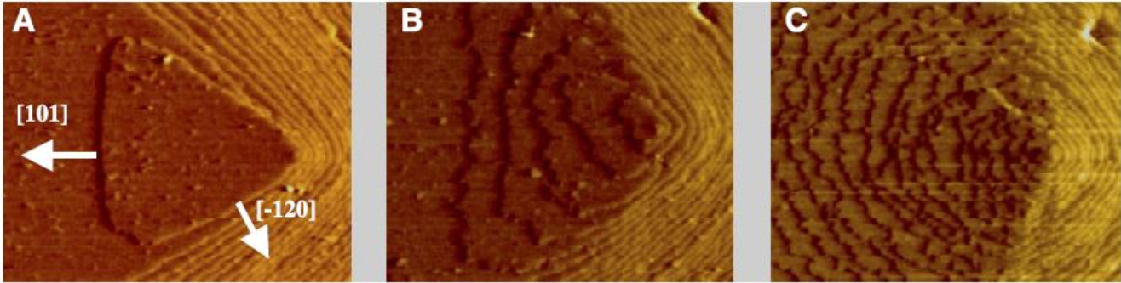
Inhibitors-Citrate
https://kidneystones.uchicago.edu/the-grand-inhibitor/#URINE%20pH

Slide 24
Inhibitors
Magnesium and pyrophosphates
It has been shown that in a supersaturated 2 mmol/L CaOx solution, magnesium reduced CaOx particle number by 50%. Thus it forms complexes with oxalate and decreases supersaturation. (Desmars and Tawashi 1973)
Likewise pyrophosphate, at low concentrations inhibits COM crystal growth by almost 50%. It inhibits the precipitation of CaP, where as diphosphates also inhibits the growth of apatite crystals (Robertson WG. Calcif Tissue Res. 1973)
Natural Polymers such as Osteopontin (OPN) and Tamm-Horsfall protein
OPN is a negatively-charged aspartic acid rich protein that inhibits growth of CaOx crystals in a supersaturated solution.
It has been shown to direct CaOx crystallisation to the CaOx dehydrate phase rather than the CaOx monohydrate (COM) phase. The dehydrate is less adherent to renal epithelial cells. (Wesson, Worcester et al. 1998)

Slide 25
Synthetic Polymers
These include surfactants, polyelectrolytes, and copolymers.
Surfactants interact with the crystal surface, resulting in different kinetic influences.
Anionic surfactant like SDS modifies CaOx crystals during nucleation to promote the formation of COD over COM through changes in the micelle-solution interface.
Akyol et al showed that promotion of COD over COM occurs when the polyelectrolyte slows the growth rate of the (-101) crystal face of CaOx. The growth rate of the other crystal faces remains unchanged (Akyol, Kırboğa et al. 2009)
Other anionic surfactant like PAA has shown to inhibit crystal growth through surface adsorption rather than chelation. (Akyol and Öner 2007)

Slide 26
Synthetic Polymers
Poly (sodium 4-styrene sulfonate) (PSS) like other synthetic polymers influences the morphology of calcium carbonate and calcium oxalate crystals.
PSS works by inhibiting the formation of calcium oxalate monohydrate (COM) phase, meanwhile promoting the formation of the calcium oxalate dihydrate (COD) phase. Further the sizes of the CaOx particles decreases with the addition of PSS.
This is attributed to the fact that it increases the concentration of calcium ions at the interface. The nucleation of CaOx easily occurs in the presence of PSS chains
Due to which, precipitation induction time decreases and number of CaOx particles increases giving smaller particles (Yu, Tang et al. 2005)
This increase in COD makes PSS an ideal candidate for the treatment of kidney stones because COD is more easily evacuated from the urinary tract.

Slide 27
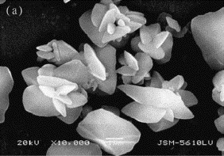
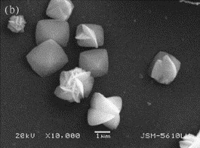
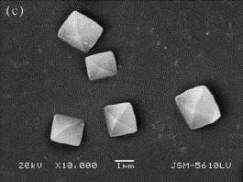
Effect of PSS on CaOx crystals
Study by Yu et al.
COM crystals in the absence of PSS (in pure water), irregular-shaped and aggregated particles were obtained at 25 C
Concentration of PSS increased to 0.1 g L⁻¹, the obtained products were composed of bipyramidal and irregular and twinned aggregated particles. COM, COD, and COT crystals were obtained and COD was the main phase.
PSS concentration at 0.2 g L⁻¹, the obtained CaOx crystals exhibited bipyramidal-shaped morphologies and smooth surfaces, typical of COD crystals
(Yu, Tang, & Cheng, 2005)

Slide 28
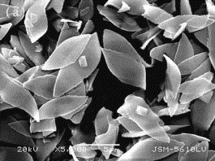
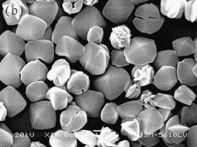
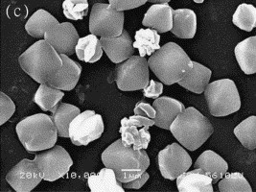
Effect of pH on CaOx crystals
Study by Yu et al.
Increasing pH, from 6, 8, and 10,the particle size decreased
With the increase in the pH, the nucleation rate increases, to such an extent that morphology control is partially lost and the average particle size slightly decreased,
This increase in nucleation rate prompts to an increase in supersaturation indicating that solution supersaturation of CaOx increases at the polymer/water interface region.
(Yu, Tang, & Cheng, 2005)

